Slide 1
1
Interactive Solar System
Computer Graphics. Final Project.
Sergio García Prados
serga155
Roberto Corrochano Piqueras
robco726
Linköping University

Slide 2
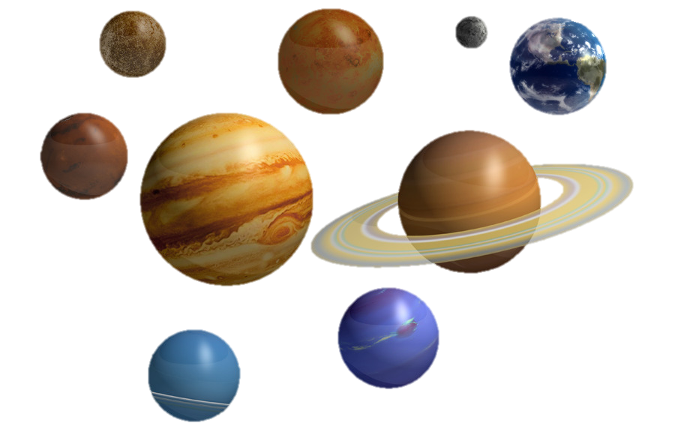
Introduction
Interactive solar system.
User controls a rocket in 3rd person.
Moves between the planets.
Differences by textures.
Differences by sizes.
Collision detection.

Slide 3
Mandatory features
The center is on the Sun.
Skybox with “space texture”.
At least 2 planets implemented.
Planets spin around the Sun. Each one has one satellite.
Spaceship implemented. Able to land, steer forward, backward, up, down and rotate around one shoulder
Collision detection.
The camera follows the spaceship.

Slide 4
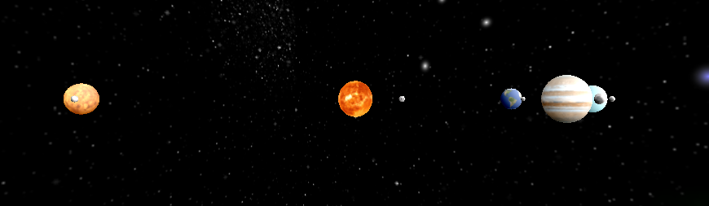
Mandatory features
The center is on the Sun.

Slide 5
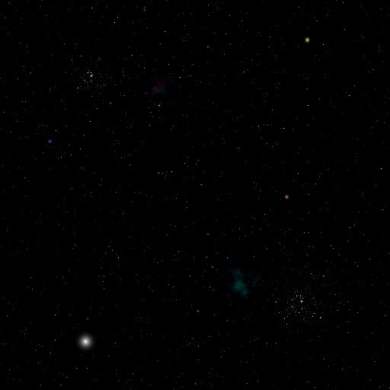
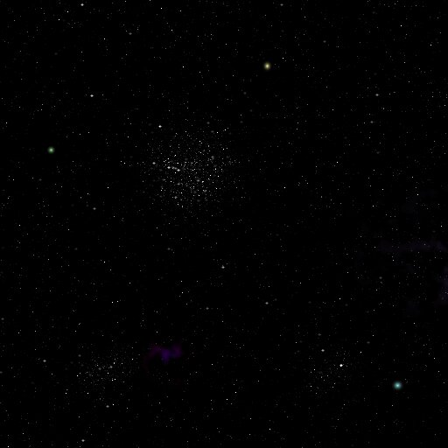
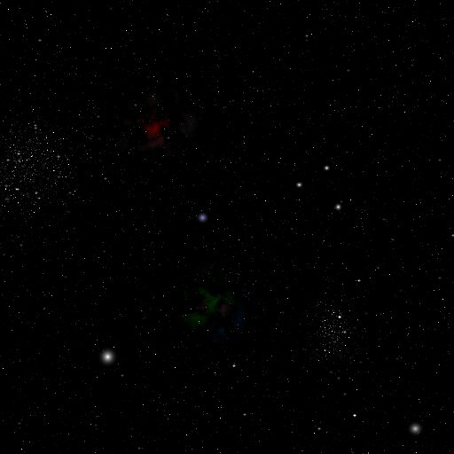
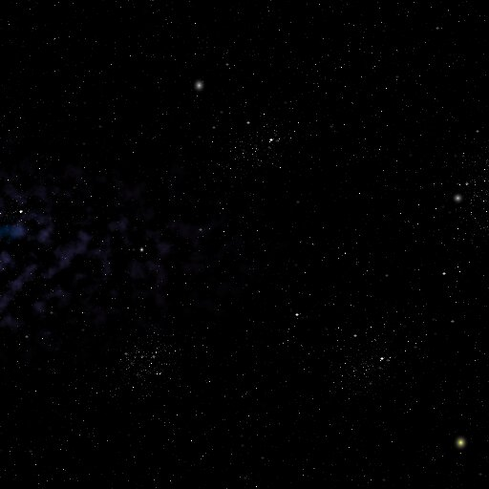
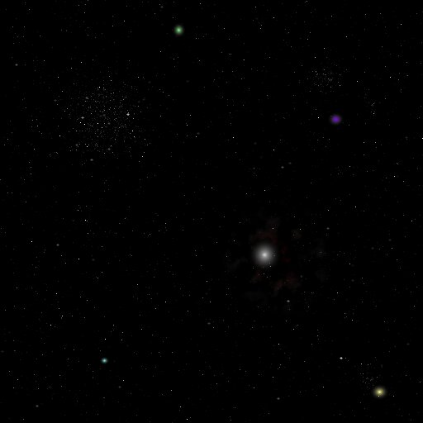
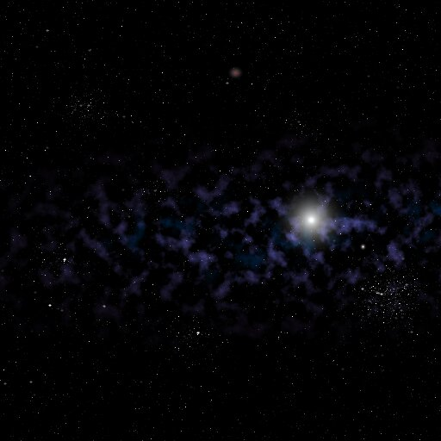
Mandatory features
Up
Skybox with “space texture”.
Left
Front
Right
Box design
Down
Back

Slide 6
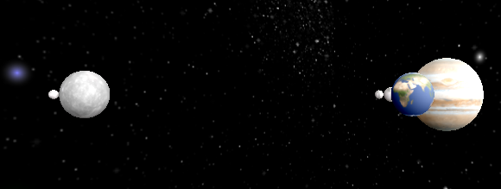
Mandatory features
At least 2 planets implemented. Each one has one satellite.
2
3
1

Slide 7
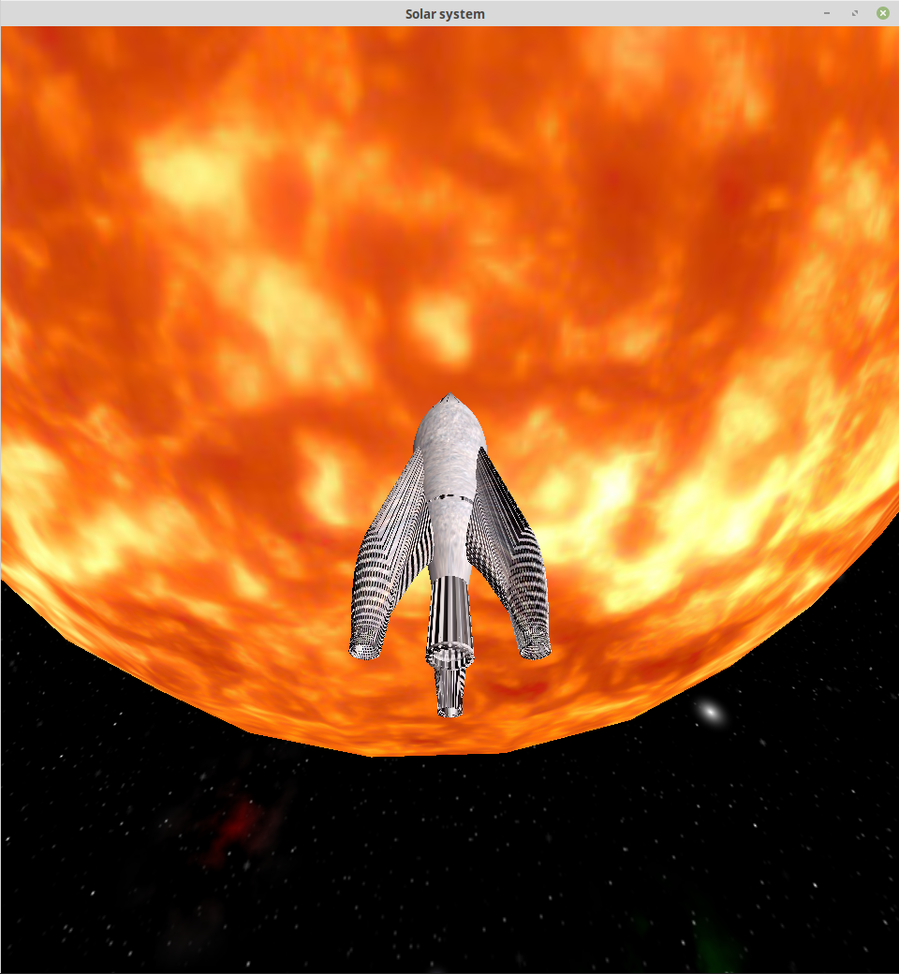
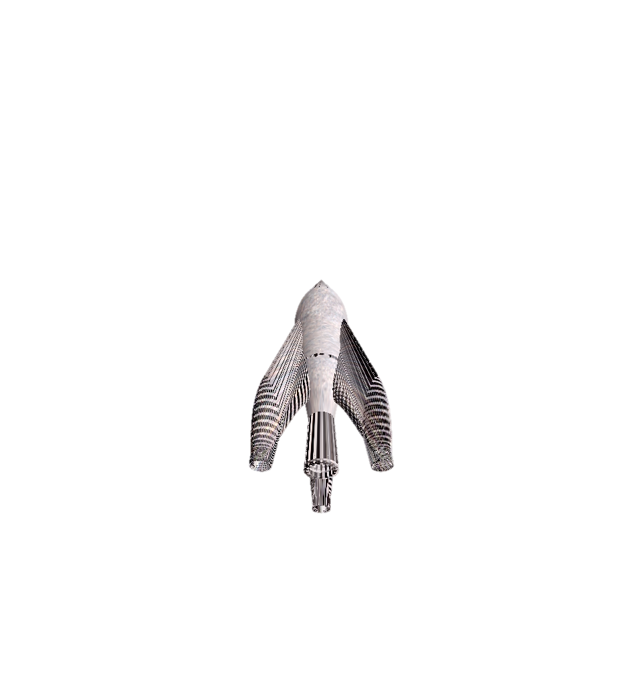

Mandatory features
Spaceship implemented.
Collision detection.

Slide 8
“Might do” features
Showing written information about the planets when landing.
Perform graphics.
Sound effects.
Earning points by special objects (rings) or shooting enemies.
Etc…

Slide 9


Implementation
LINUX

Slide 10
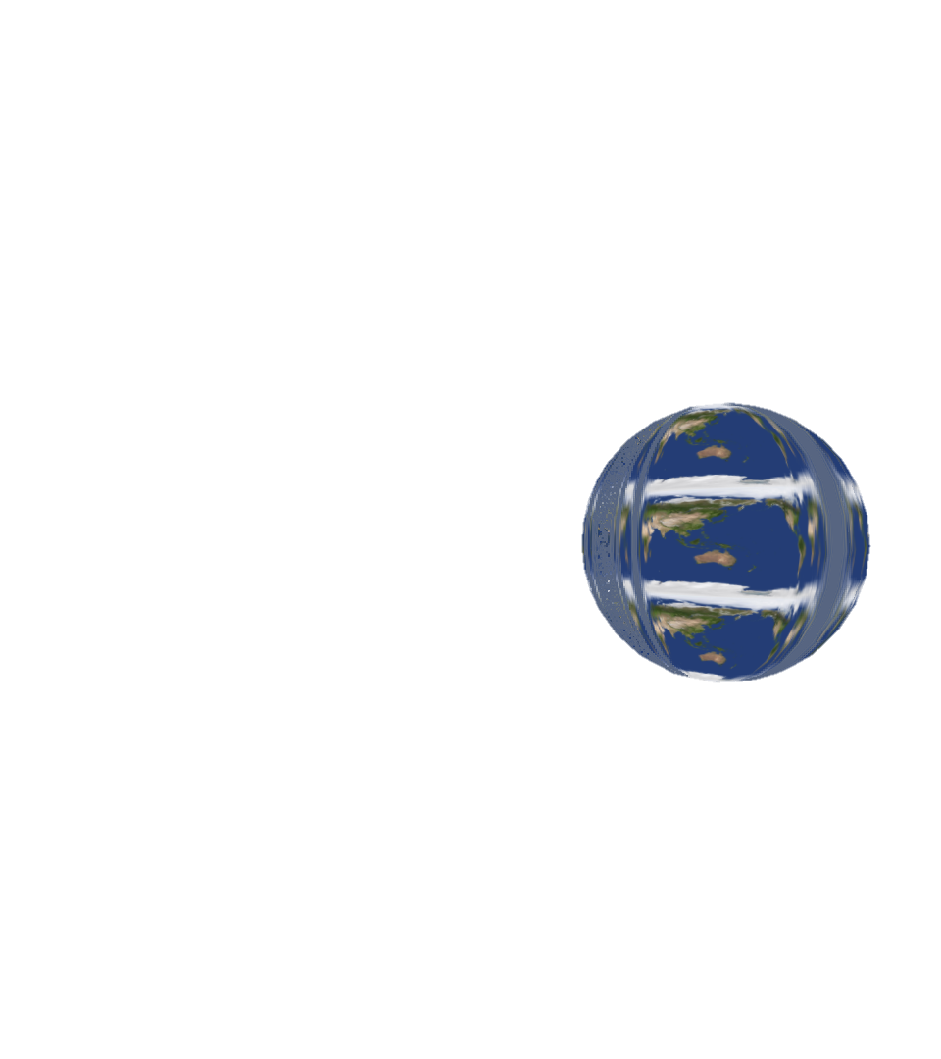

Problems
Texture of the planets
FIXED!
Later on…

Slide 11
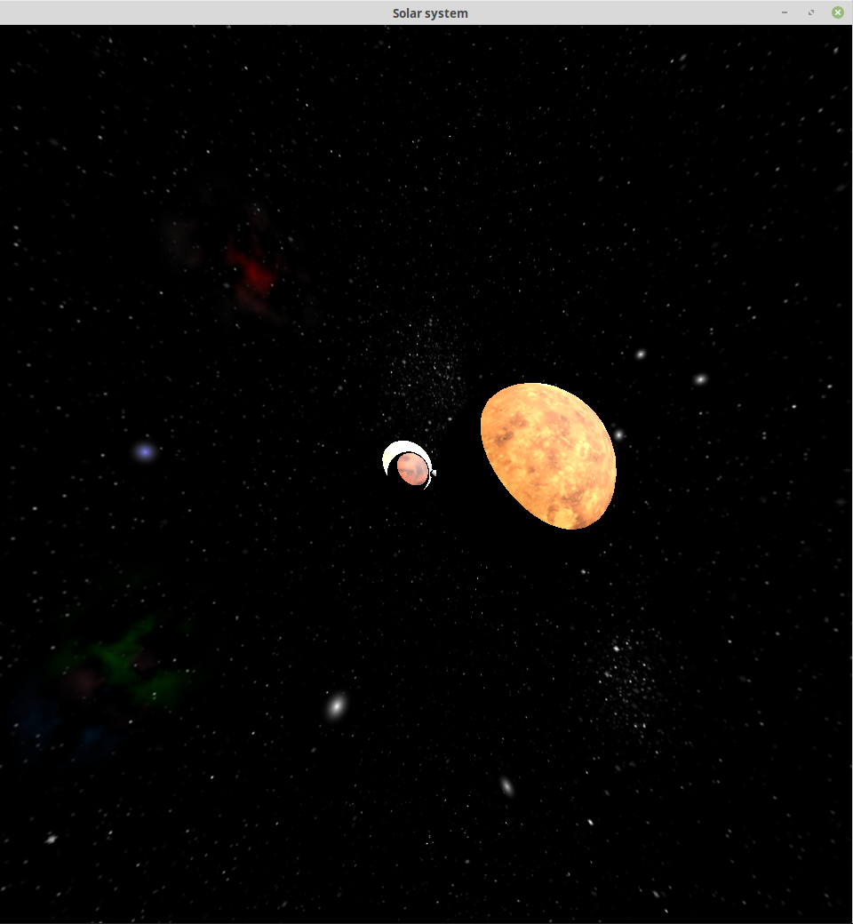
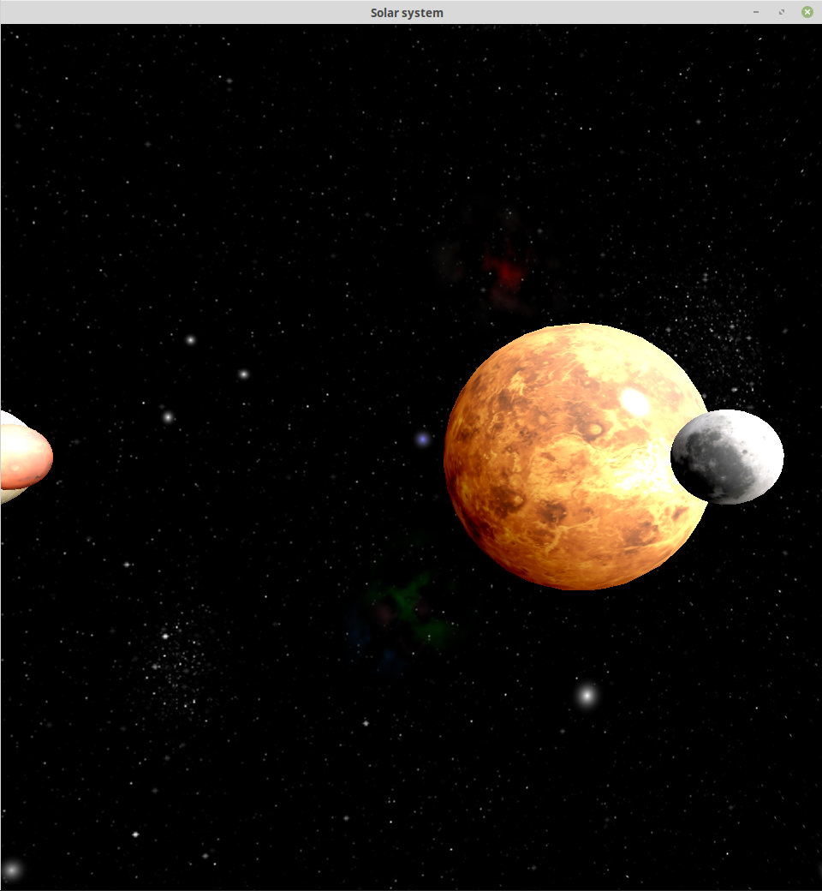
Problems
Bad shading
FIXED!
Later on…

Slide 12
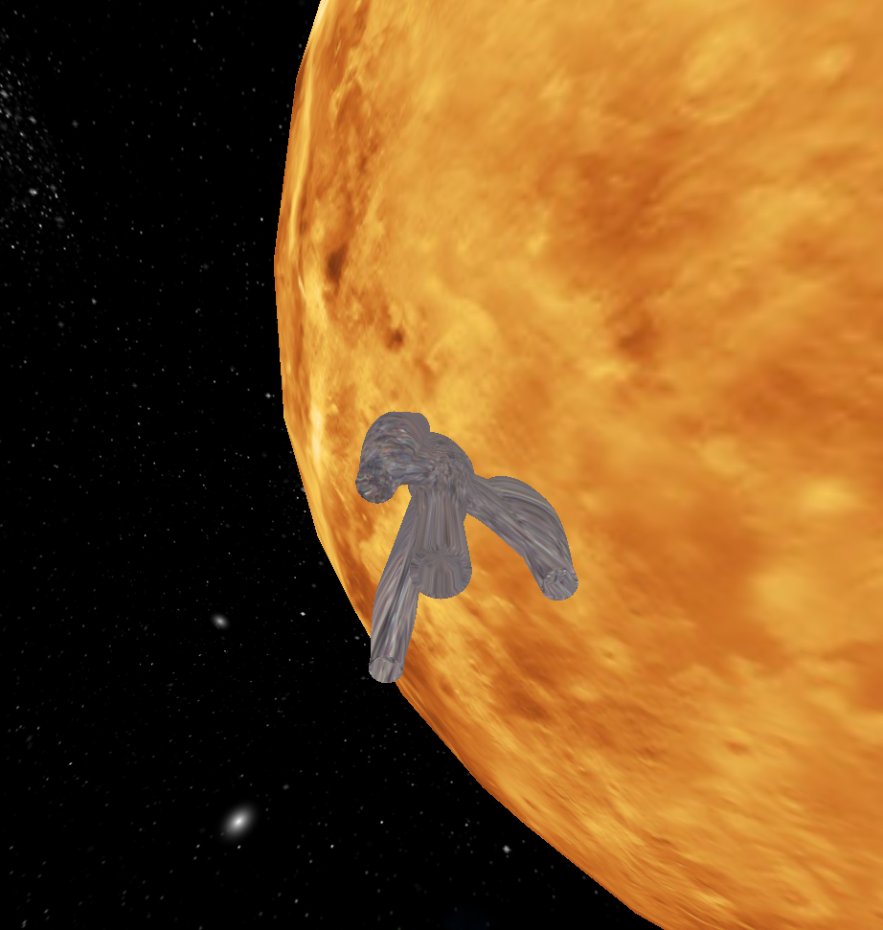
Problems
FIXED!
Collision detection.
Later on…

Slide 13
CONCLUSIONS
Now we can notice how many animations are really done.
Funny and nice.
It allows many performances, improvements and other ideas to apply.
Opened our mind in the Computer Graphics field.
Simpler tan other kind of projects because of studying abroad difficulties.

